Slide 1

WAY TO ENTERPRISE
React JS
VTI ACADEMY
Author: duy.nguyenngoc1@vti.com.vn
March 2020

Slide 2
Agenda
Axios
Higher-Order Component
Render props
Reuse function
Assignments
Copyright © VTI Academy All Rights Reserved

Slide 3
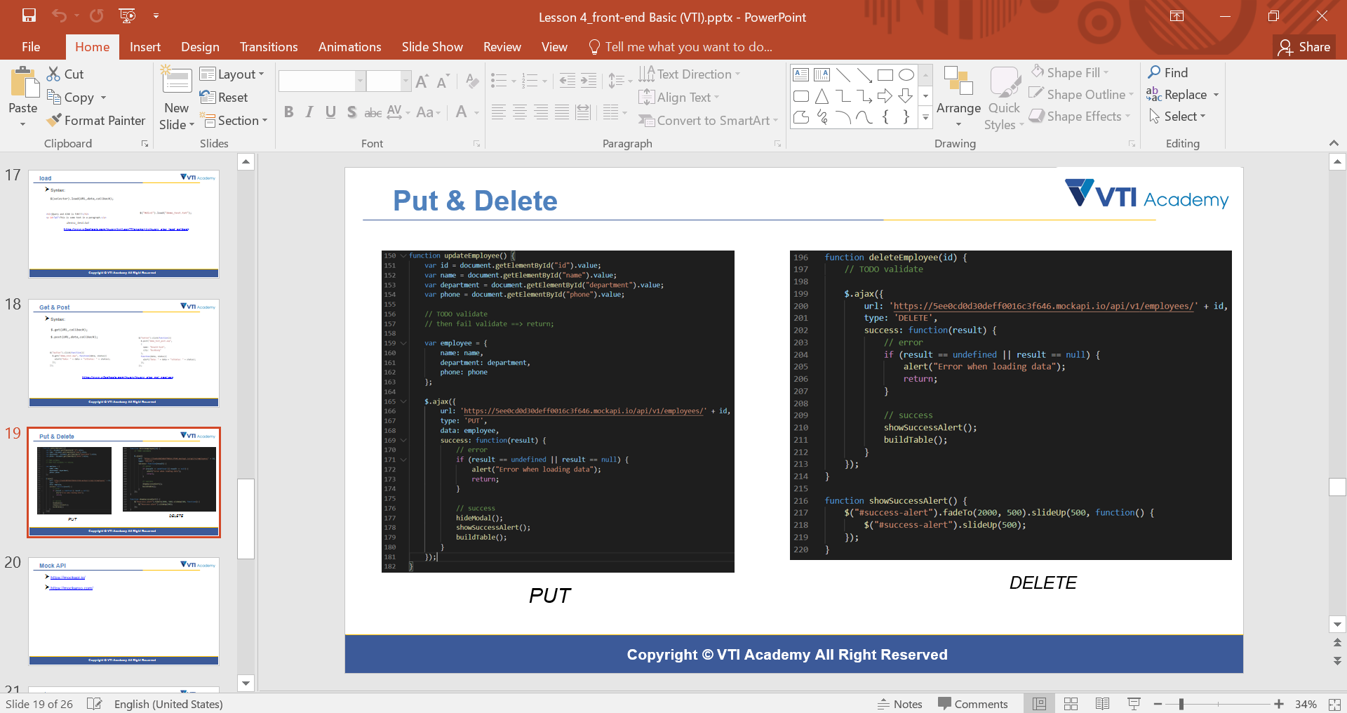
API
XHR (XML HttpResquest)
Fetch
Axios (recommended)
JQuery (Ajax) in Basic Front-end

Slide 4
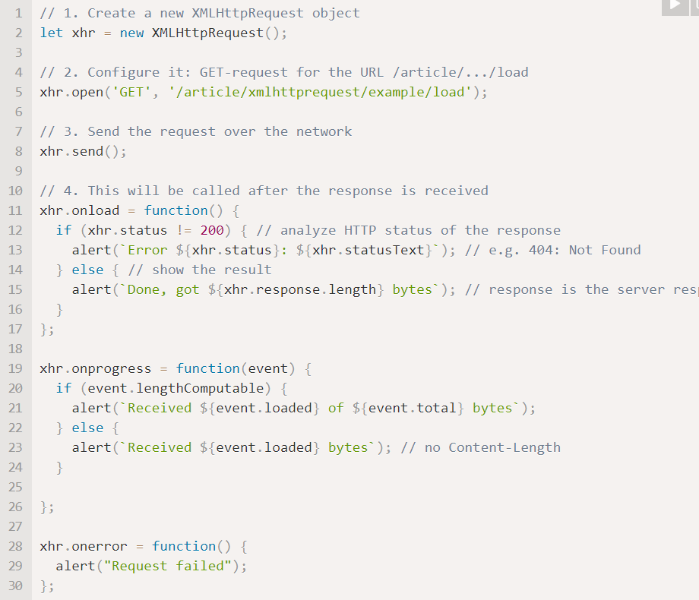
XHR
Using callback
Older
https://javascript.info/xmlhttprequest

Slide 5
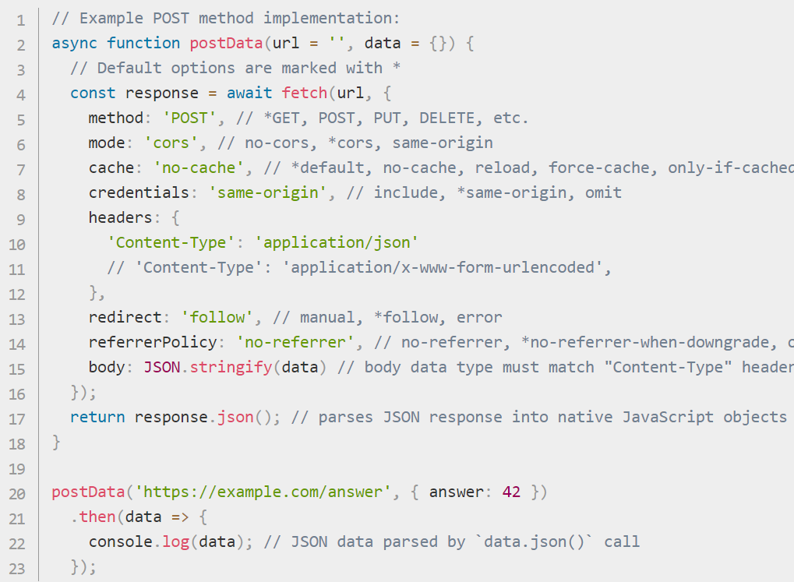
Fetch
Available
Support promise, async await
https://developer.mozilla.org/en-US/docs/Web/API/Fetch_API/Using_Fetch

Slide 6
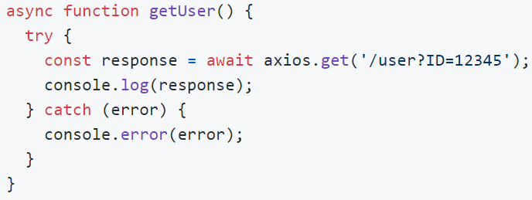
Axios
Library
Support promise, async await
Automatic transforms for JSON data
Intercept request and response
Block request & response
Cancel request
Protecting against XSRF
https://github.com/axios/axios

Slide 7
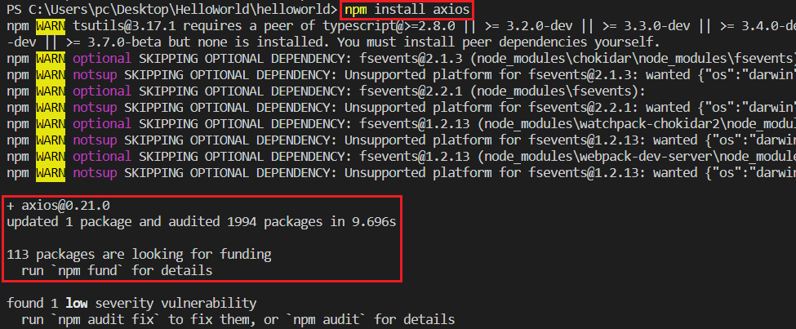
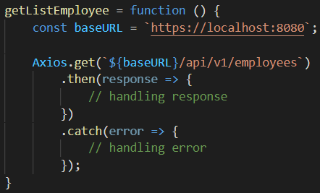
Axios
Example 1:
npm install axios
Get all()
View source code in Lesson_7_Resource

Slide 8
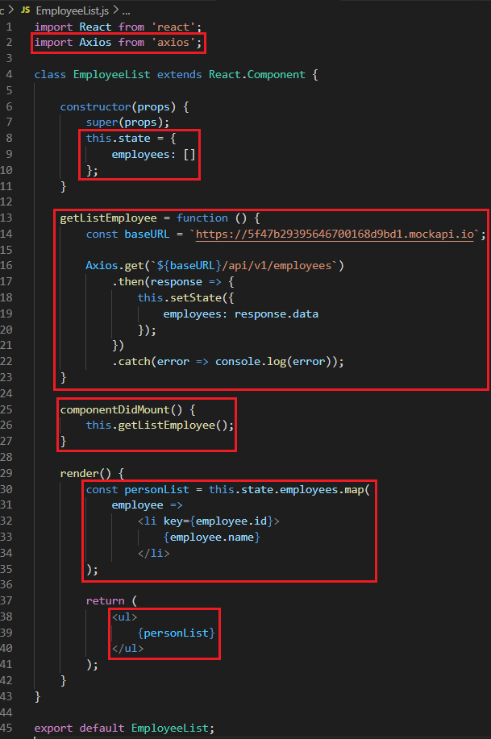
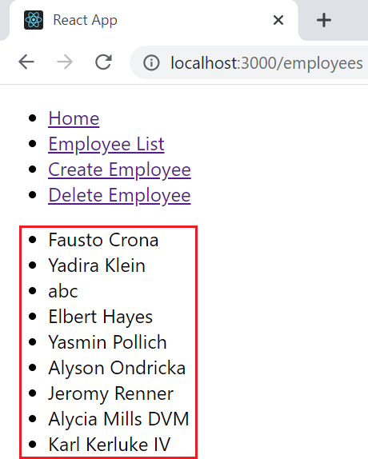
Axios

Slide 9
Testing System Assignment
Self-practice

Slide 10
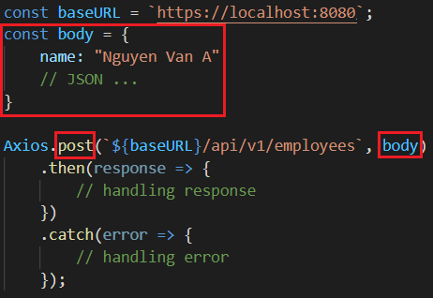
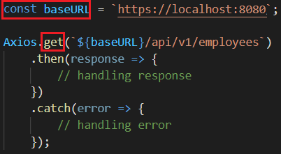
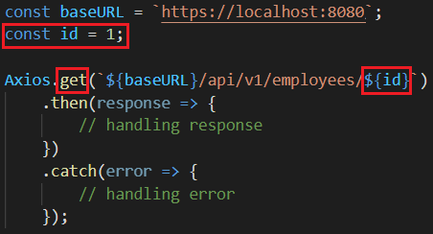
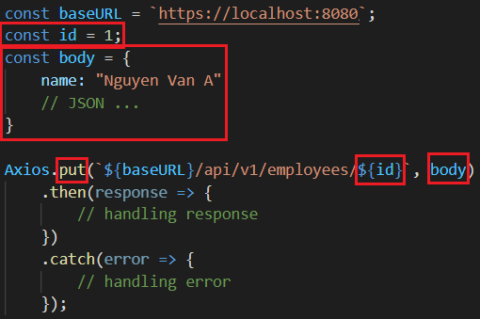
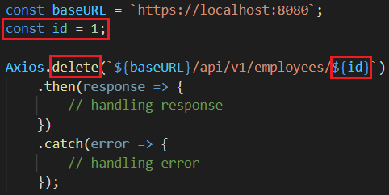
Basic CRUD
Promise
Get all
Get by id
Create
Update
Delete

Slide 11
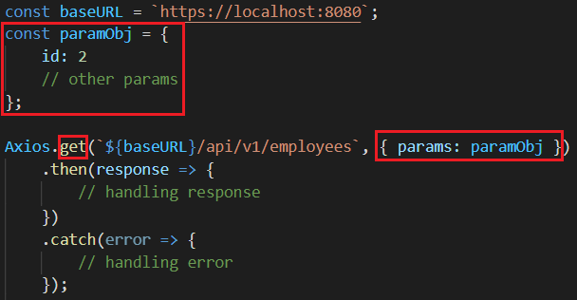
Params Object
Way 1 (not recommended)
Way 2 (recommend)
Get by id

Slide 12
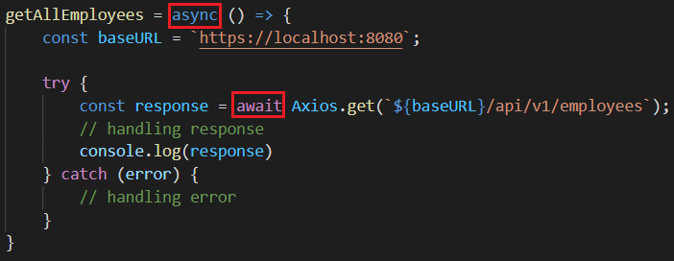
Promise & Async await
Promise
Async Await

Slide 13
Testing System Assignment
Self-practice

Slide 14
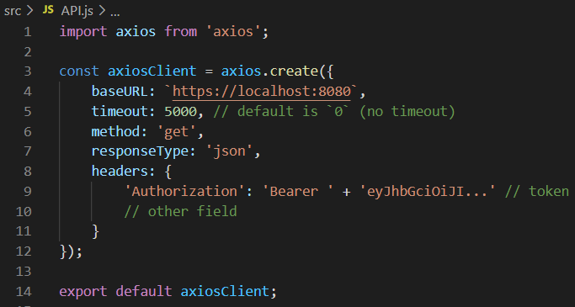
Create axios instance
Axios.create([config])
https://github.com/axios/axios#request-config

Slide 15
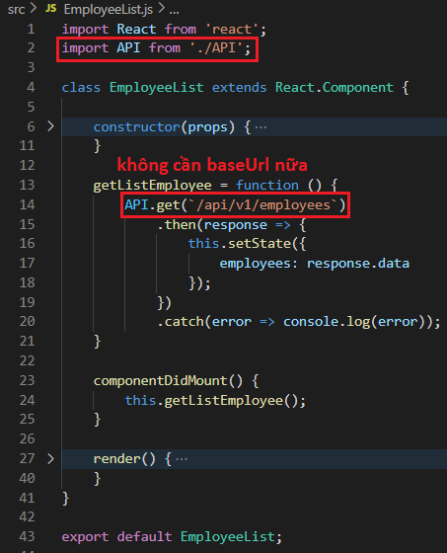
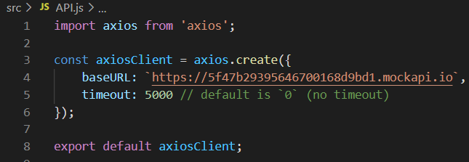
Create axios instance
Example 2:
Create axios instance
Using
View source code in Lesson_7_Resource

Slide 16
Testing System Assignment
Self-practice

Slide 17
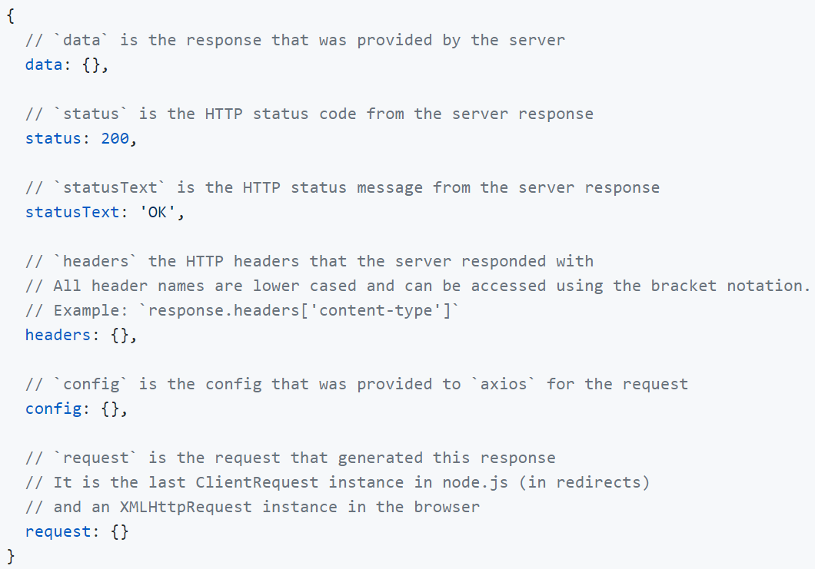
Response structure

Slide 18
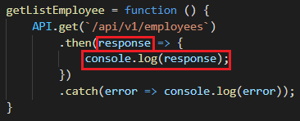
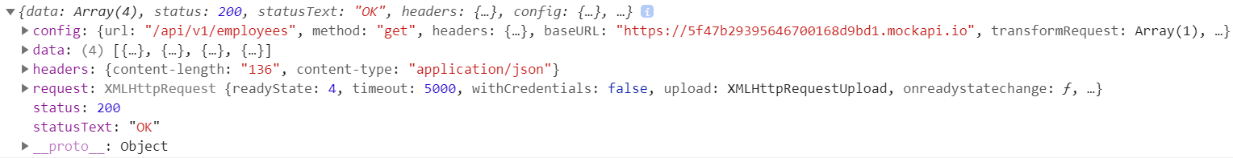
Response structure
Example:

Slide 19
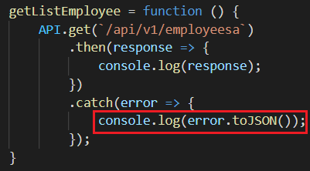
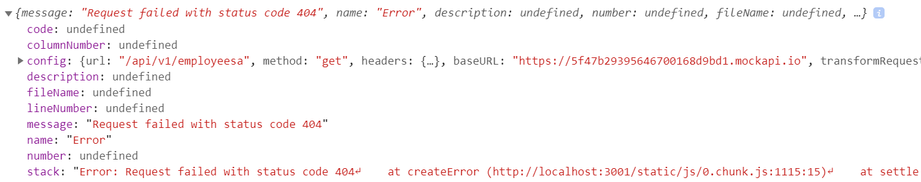
Handling error
Return the response when the server has received the request
Return the request when the server has not received the request
Example 1:

Slide 20
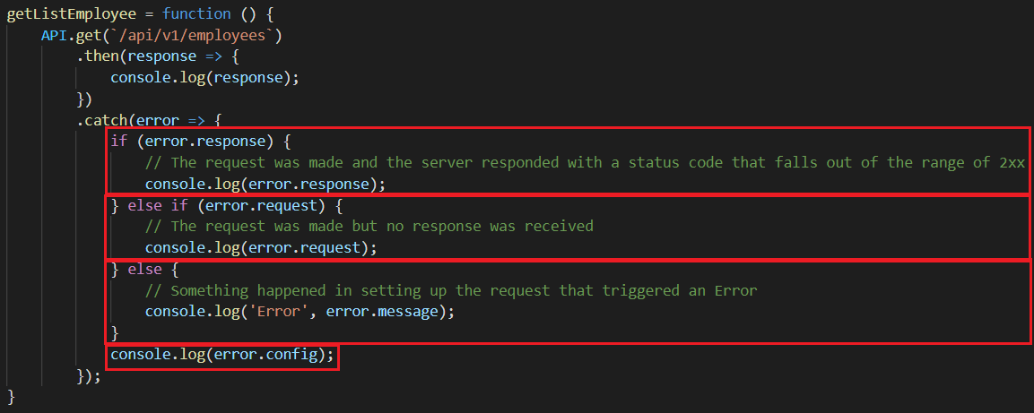
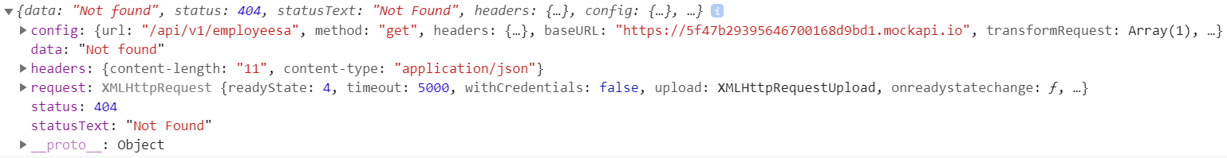
Handling error
Example 2:
error.response

Slide 21
Testing System Assignment
Self-practice

Slide 22
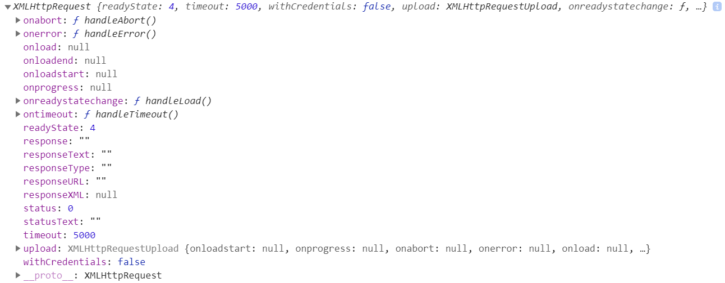
Handling error
error.request

Slide 23
Cancel Request
https://github.com/axios/axios#cancellation

Slide 24
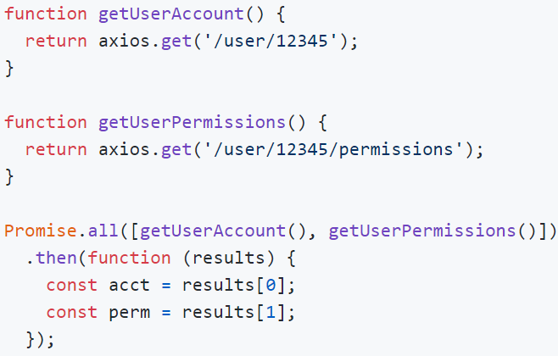
Performing multiple concurrent requests

Slide 25
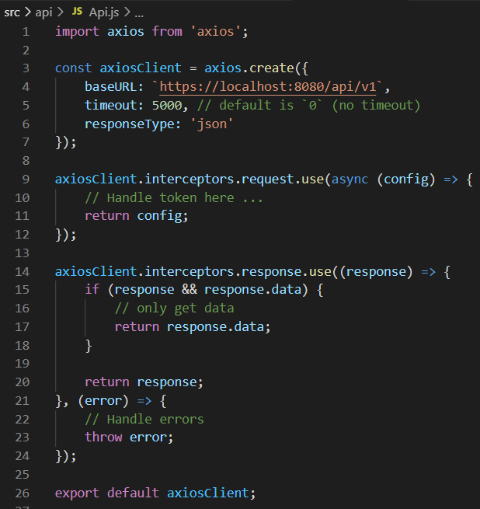
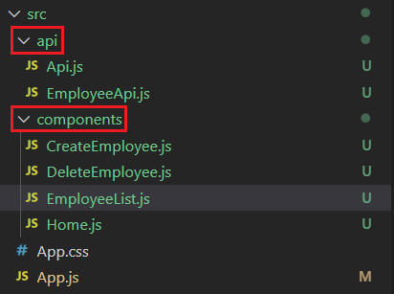
API Organization
Should split into separate API files
Do not create the base API
Create axios instance

Slide 26
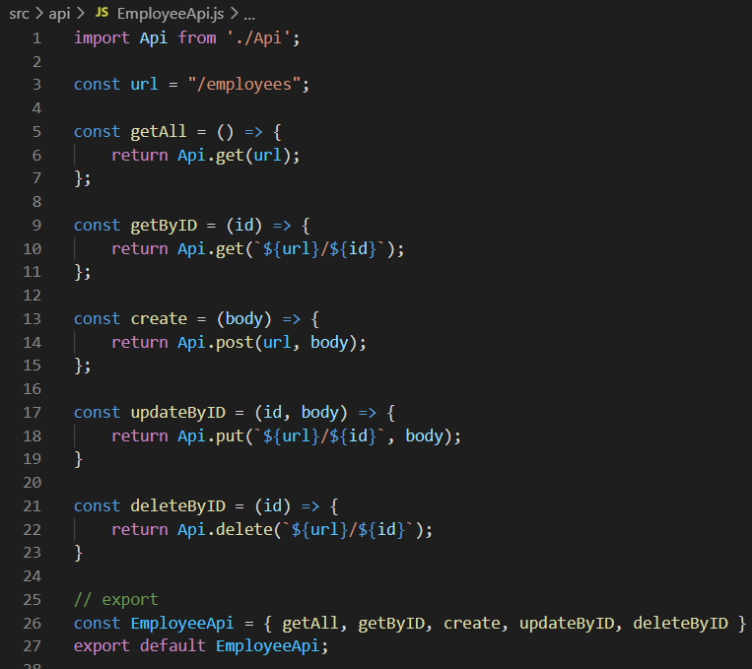
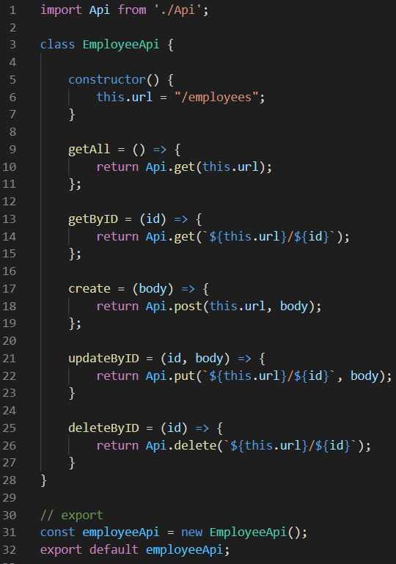
API Organization
Export function
Export class
Each 1 model should be 1 api file

Slide 27
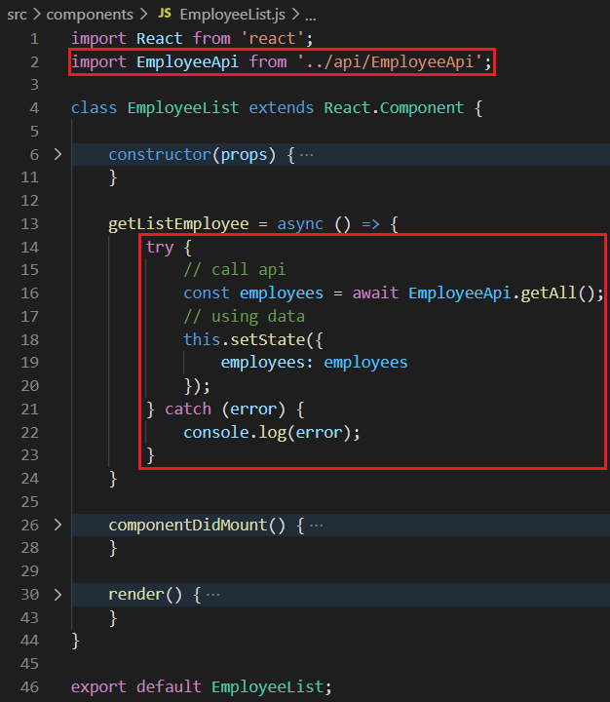
API Organization
Using
View source code in Lesson_7_Resource

Slide 28
Testing System Assignment
Self-practice

Slide 29
Reuse code
Higher-Order Component (HOC)
Render props
Reuse function

Slide 30
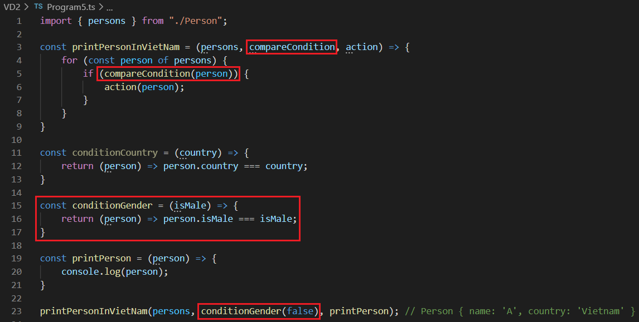
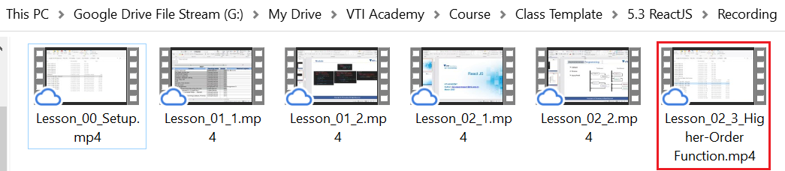
Higher-Order Function (HOF)
Combine small functions into one complex function (reusable small functions)
HOF can take one or more functions (like arguments) and can be return a new Function
Recording
Similar to abstract

Slide 31
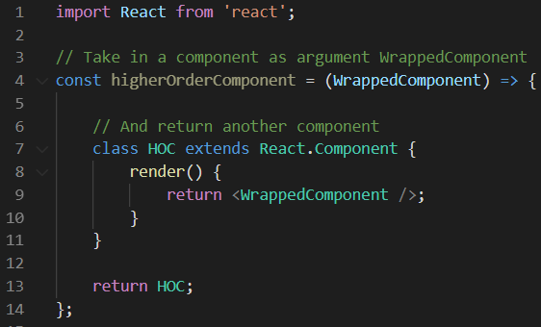
Higher-Order Component (HOC)
HOC can take one or more components (like arguments) and return a new Component
Is technical (not React’s API )
Syntax

Slide 32
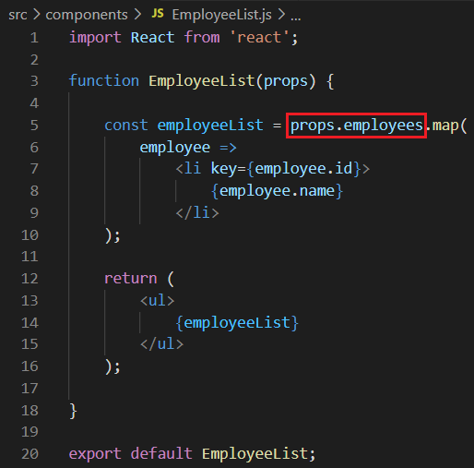
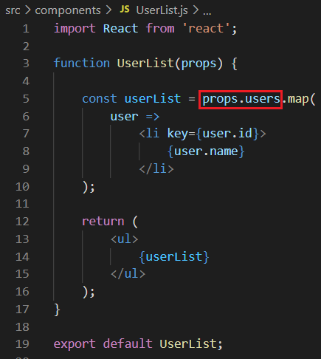
Example 1: Show loading when loading data
Component UI
Component UI
View source code in Lesson_7_Resource

Slide 33
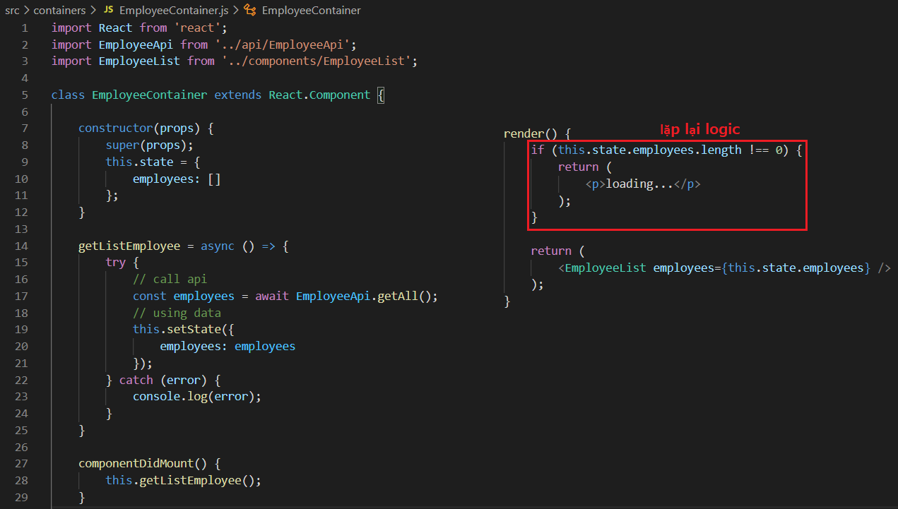
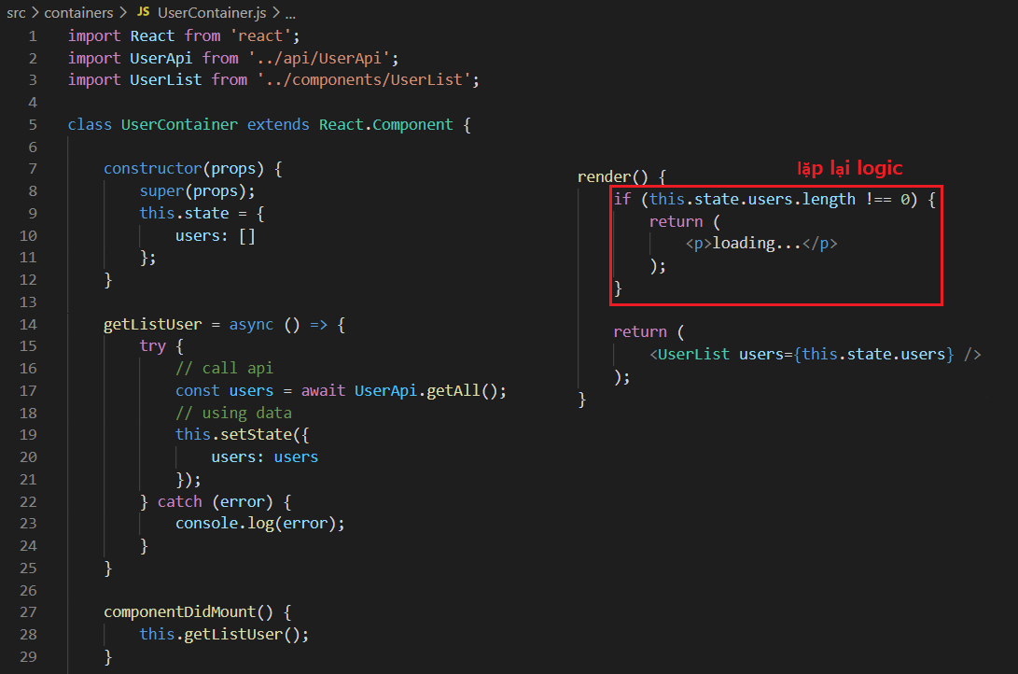
Example 1: Show loading when loading data
Container
Container
Loading logic duplicate

Slide 34
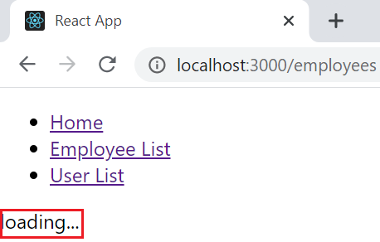
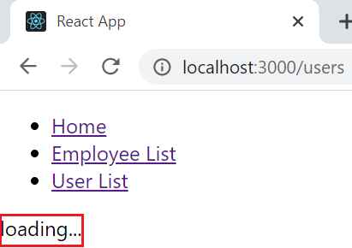
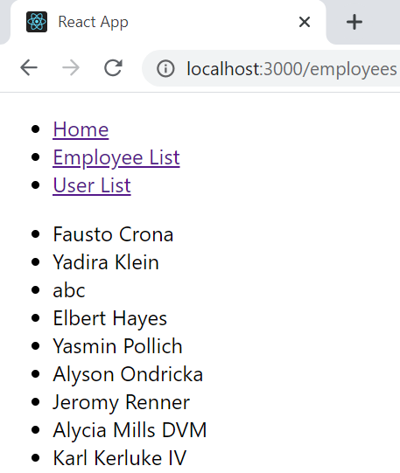
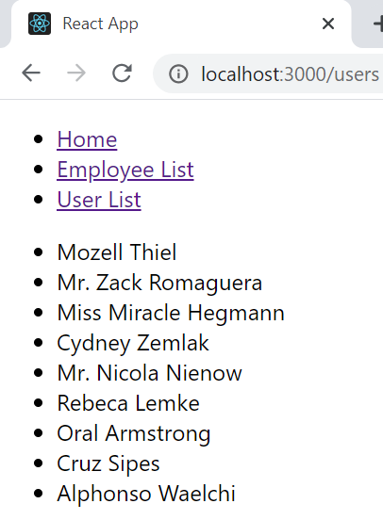
Example 1: Show loading when loading data
Employee Page
User Page

Slide 35
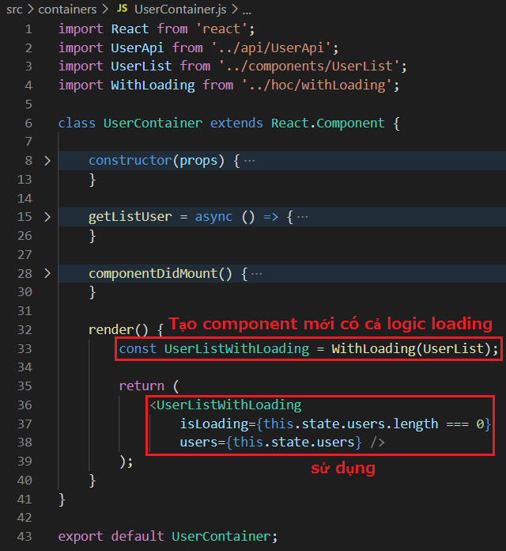
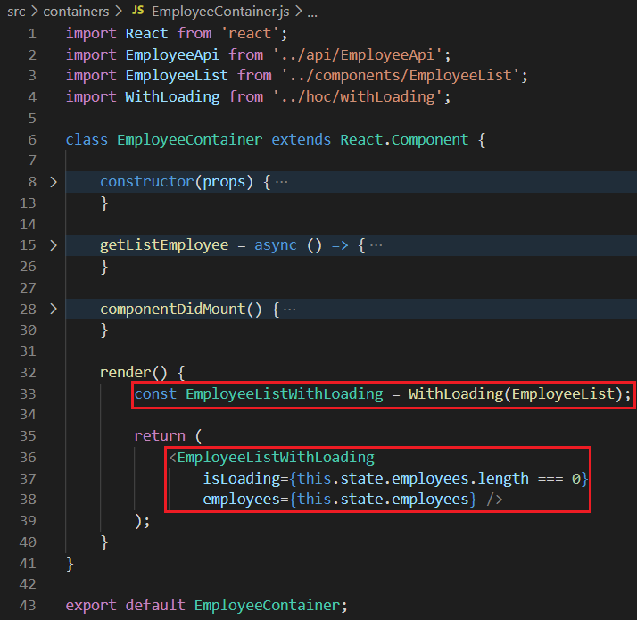
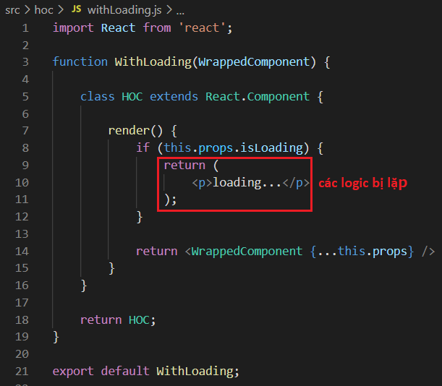
Example 1: Show loading when loading data
Create withLoading() HOC
View source code in Lesson_7_Resource

Slide 36
Testing System Assignment
Self-practice

Slide 37
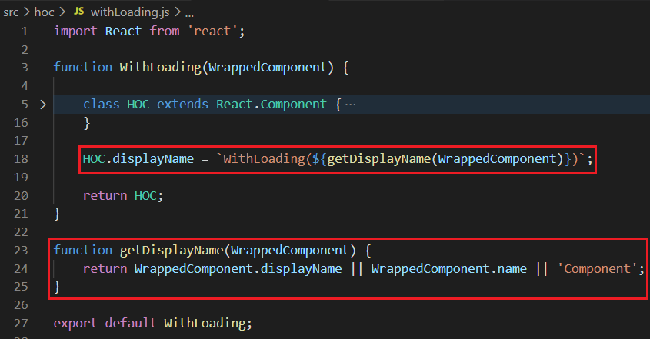
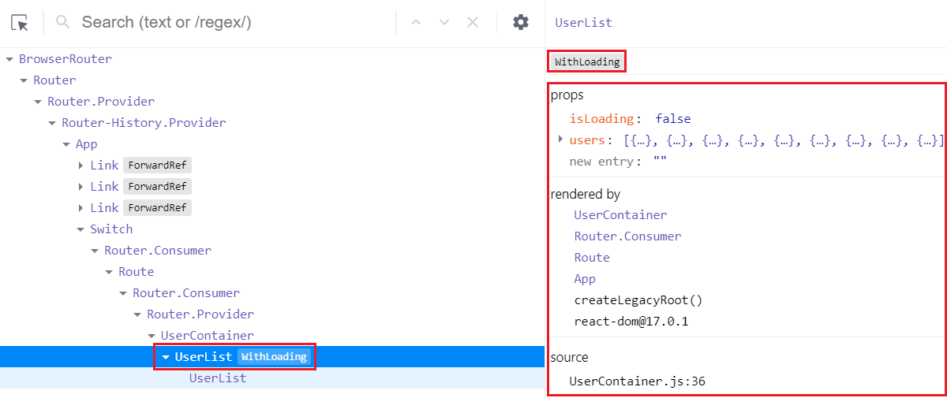
displayName
View source code in Lesson_7_Resource

Slide 38
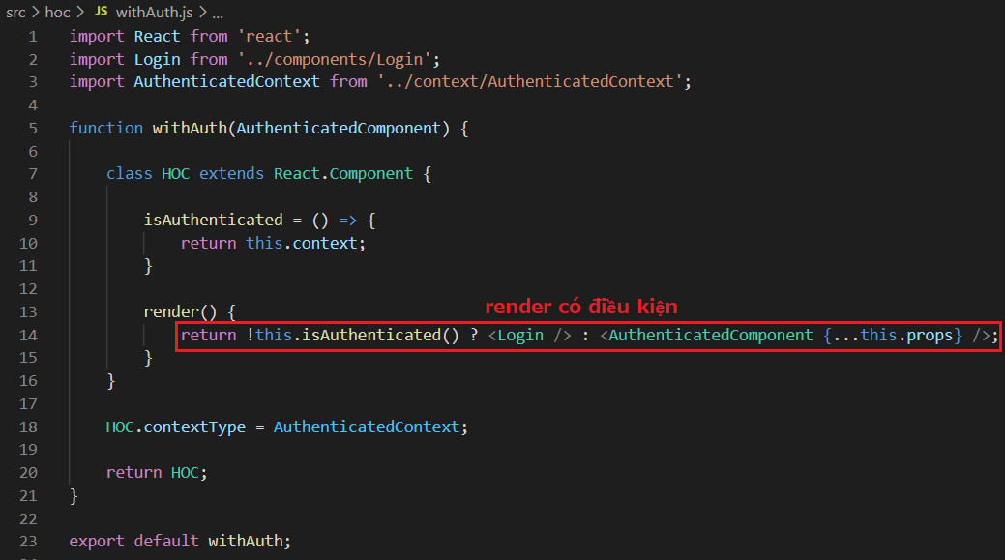
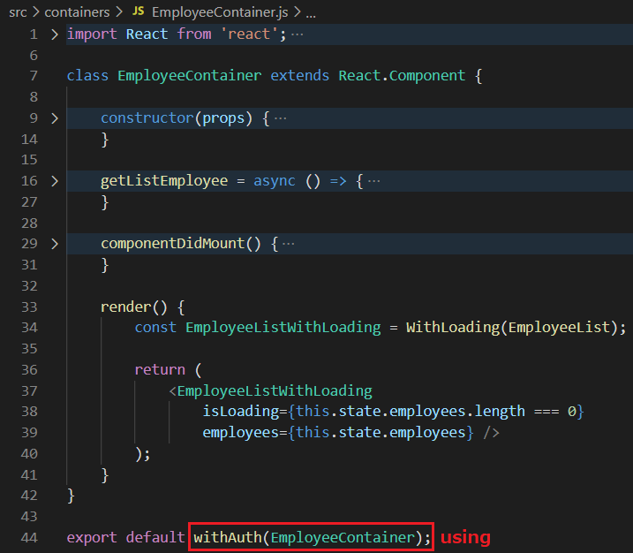
Example 2: Login checking
View source code in Lesson_7_Resource

Slide 39

Example 2: Login checking
View source code in Lesson_7_Resource

Slide 40
Testing System Assignment
Self-practice

Slide 41

Testing System Assignment
Exercise 2: Higher-Order Components – Question 5,a

Slide 42




Example 3: Styling
View source code in Lesson_7_Resource

Slide 43



Example 4: default props
View source code in Lesson_7_Resource

Slide 44


Example 5: multiple HOC
View source code in Lesson_7_Resource

Slide 45
Testing System Assignment
Self-practice

Slide 46

HOC Summary
HOC can take one or more components (like arguments) and return a new Component
Use case
Reuse code, maintain
Conditional component render
Provide props
Note
Don’t Use HOC Inside the render Method
HOC packages the original component (wrapper component) into a Container Component

Slide 47
HOC Summary
Disadvantages
Nested ➔ don't know which HOC's props ➔ easy to override

Slide 48



Render Props
Render callback, function as child
Passed to component 1 props with the value as callback function
Syntax
Do not hardcode inside HOC
Similar to callback in Lesson 5

Slide 49




Render Props
Example 1:
Using HOC

Slide 50



Render Props
Example 1:
The idea is clearer, separated into a Mouse component specializing in providing coordinates
Using Render Props

Slide 51
Testing System Assignment
Self-practice

Slide 52


Render Props
Example 2: convert Render Props to HOC
HOC

Slide 53


Render Props
Example 2: convert render props to HOC
Using

Slide 54



Render Children
Using: Way 1
Using: Way 2

Slide 55
Testing System Assignment
Self-practice

Slide 56

Render Props & HOC Comparison
HOC packages the original component (wrapper component) into a Container Component
Render props return data through callback
🡺 do not hardcode inside HOC
https://medium.com/ingenious/a-tale-of-higher-order-components-render-props-a1ba47e8cfeb

Slide 57

Render Props Summary
Disadvantages
Using multiple render props in a component which can create many nested callbacks
➔ hard to see ➔ using HOC
Used library
React-Router
Formik
https://reactrouter.com/web/api/Route/render-func

Slide 58



Reuse Function
Similar to importing & exporting in Typescript
Export class

Slide 59
Testing System Assignment
Self-practice

Slide 60

Testing System Assignments

Slide 61
Reference
https://reactjs.org/docs/getting-started.html
https://www.javatpoint.com/reactjs-tutorial
https://www.udemy.com/course/react-the-complete-guide-incl-redux

Slide 62
Q & A
Copyright © VTI Academy All Rights Reserved

